Slide 1
Logic gates and operations

Slide 2
Binary Logic
It deals with binary variables (i.e., 0 and 1).
Binary variables are denoted by x, y, z, A, B, C, etc.,
Three basic operations – AND , OR and NOT.
NOT operation is represented as x’.

Slide 3
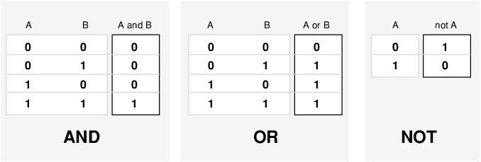
Truth Tables for logical operations

Slide 4
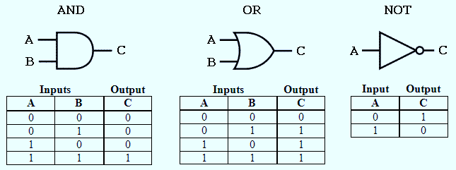
Logic gates
logic gates that perform logical operations AND, OR, & NOT are known as AND gate, OR gate, NOT gate.

Slide 5
